Slide 1
Entity Relationship Diagram
Prepared by
Anisha Radhakrishnan
Asst Prof
CSE Department

Slide 2
ER Diagram
ENTITY RELATIONAL (ER) MODEL is a high-level conceptual data model diagram.
It’s a pictorial representation.
Why ER diagram
ER modeling helps you to analyze data requirements systematically to produce a well-designed database.
The Entity-Relation model represents real-world entities and the relationship between them.
It is considered a best practice to complete ER modeling before implementing your database.

Slide 3
Entity Relationship
The ER model defines the two important steps. It has real-world entities and the associations among them.
At view level (user level) , the ER model is an excellent option for designing databases.
Requirement Analysis
Conceptual Database Design

Slide 4

The initial step in designing a database application is to understand
what data to be stored in the database,
applications must be built on the top of it, and what operations are we must find out what the users want from the database.
Eg: Design E-commerce Database

Slide 5
Conti...
Can you identify the requirements for designing
E-commerce
Customer
Product Catalog
Location Details
Payment

Slide 6
Conceptual Design
The information gathered in the requirements analysis step is used to develop description of the data to be stored in database, along with the constraints known to hold over the data.
Customer – c_id varchar2(20) PK , c_name , address varchar2(20)
Product Catalog - p_id varchar2(20) PK
Location Details – c_id varchar2(20) FK, deli__date date
Payment - invoice_id varchar2(20) PK , varchar2(20), amount float

Slide 7
Conti...
We must choose a DBMS to implement our database design.
convert the conceptual database design into a database schema in the data model of chosen DBMS.
ERD to relation
Relational Model

Slide 8
GUI– view level
Schema – conceptual level
Disk Storage Physical Level

Slide 9
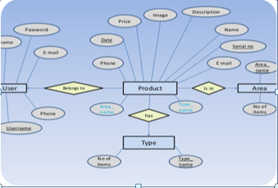
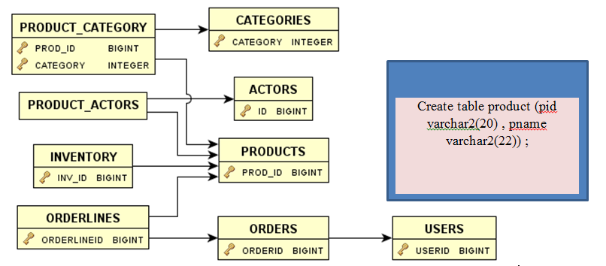
Schema – conceptual level

Slide 10
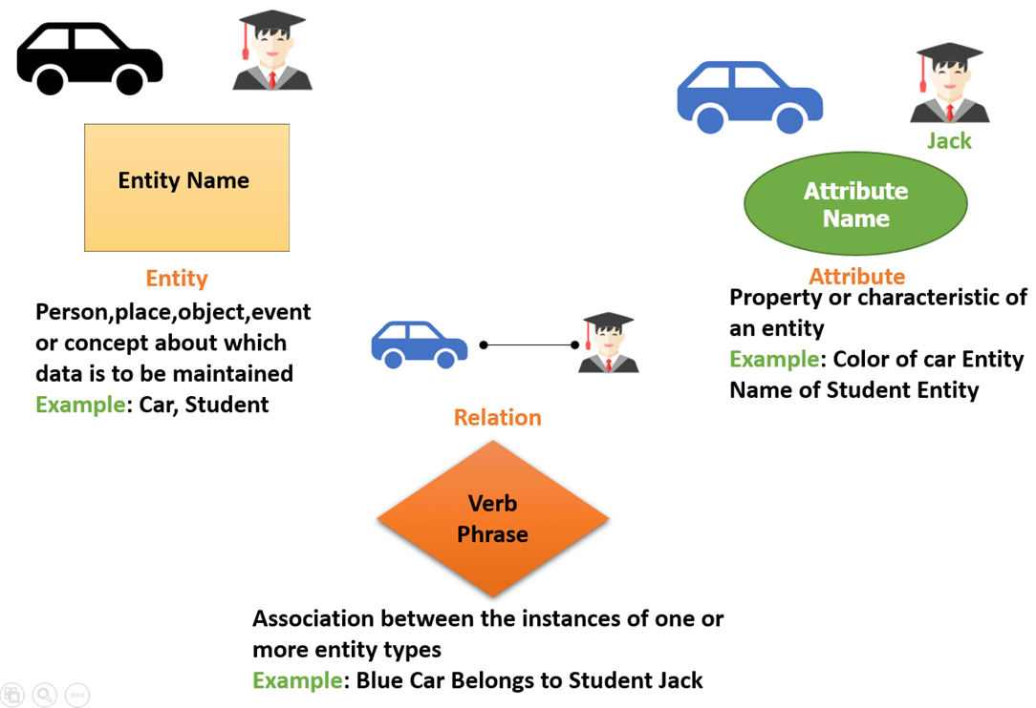

Slide 11

Components of ER Diagram
An entity can be a real-world object, that can be easily identifiable.
For example, in a school database, students, teachers, classes, and courses offered can be considered as entities. All these entities have some attributes or properties that give them their identity
Entity is represented in rectangle shape
Entity

Slide 12
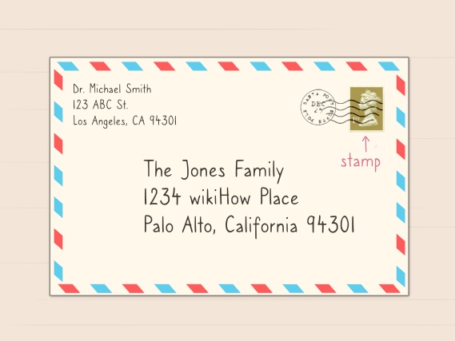



Components of ER Diagram
Entities are represented by means of their properties, called attributes. All attributes have values.
Represented in Oval
Attributes
Person is an object

Slide 13
Example :Entity and attributes
ADDRESS
PHONE NUMBER
NAME
PERSON
Can you identify Entity and attributes for the following:
E-Reservation
Online cab booking

Slide 14
Types of Attributes
Simple attribute :- cannot be divided further Eg: Roll Number
Multivalued attribute :- More than one value possible
Eg: Phone number , Skills of a person
Composite attribute :- can be divided further Eg: Address ( street lane , city , country ), Name ( First name , Last Name )
Derived attributes are the attributes that do not exist in the physical database, but their values are derived from other attributes present in the database Eg : age derived from DOB

Slide 15
Composite attribute
Multivalued attribute
Simple attribute
address
Phone_ number
Height
Street__no
city
Aadhar_no
PERSON
Key attribute
DOB
Derivedattribute
age

Slide 16
Relationship
How to represent relationship between the entities ?
The association among entities is called a relationship.
For example, an employee works_at a department, a student enrolls in a course. Enrolls , works at are called relationships
Relationship
enrolls
student
course

Slide 17
SELF REFERENCING
supervised
prerequisit
Employee
Subject

Slide 18
Degree of Relationship:
The number of participating entities in a relationship defines the degree of the relationship.
Binary = degree 2
Ternary = degree 3
n-ary = degree
Binary
enrolls
student
course

Slide 19
Ternary Relationship
Instructor
ternary
allot_grade
student
course

Slide 20
N-ary relationship
Instructor
n-ary
offers
student
course
class_room

Slide 21
Exercise
A company has several departments. Each department has a supervisor and at least one employee. Every supervisor has only one department under him. Employees must be assigned to at least one, but possibly more departments. At least one employee is assigned to a project. Each employee is assigned atleast one project. The important data fields are the names of the departments, projects, supervisors and employees, as well as the supervisor and employee number and a unique project number.

Slide 22
Identify Entities
A company has several departments. Each department has a supervisor and at least one employee. Every supervisor has only one department under him. Employees must be assigned to at least one, but possibly more departments. At least one employee is assigned to a project. Each employee is assigned atleast one project. The important data fields are the names of the departments, projects, supervisors and employees, as well as the supervisor and employee number and a unique project number.

Slide 23
Entities
project
supervisor
Employee
Department

Slide 24
Identify Attributes
A company has several departments. Each department has a supervisor and at least one employee. Every supervisor has only one department under him. Employees must be assigned to at least one, but possibly more departments. At least one employee is assigned to a project. Each employee is assigned atleast one project. The important data fields are the names of the departments, projects, supervisors and employees, as well as the supervisor and employee number and a unique project number.

Slide 25
Attributes
S_id
S_name
P_name
P_no
project
supervisor
Employee
Department
E_id
E_name
D_id
D_name

Slide 26
Identify relationship
A company has several departments. Each department has a supervisor and at least one employee. Every supervisor has only one department under him. Employees must be assigned to at least one, but possibly more departments. At least one employee is assigned to a project. Each employee is assigned atleast one project. The important data fields are the names of the departments, projects, supervisors and employees, as well as the supervisor and employee number and a unique project number.

Slide 27
Attributes
S_id
S_name
P_name
P_no
project
supervisor
assigned
manages
works
Employee
Department
E_id
E_name
D_id
D_name

Slide 28
Thank you

